Slide 1
Overlap analysis and physical item usage for weeding (deselection) in Alma Analytics
Yoel Kortick
Senior Librarian
June 2025

Slide 2
Agenda
Introduction
Accessing the default overlap reports and dashboard
Determining the overlap analysis method
Running the default overlap reports and dashboard
Running the default physical item usage for weeding report

Slide 3
Introduction

Slide 4
Introduction
The scholarly and academic literature attests to the increasing importance of physical space in the library.
Lets take a look at a few quotes.

Slide 5
Introduction
“Physical space in an academic library is increasingly important to fully support students' diverse needs for learning spaces. ”
  What Matters for Students' Use of Physical Library Space? Seung Hyun Chaa, Tae WanKimb. The Journal of Academic Librarianship. Volume 41, Issue 3, May 2015, Pages 274-279. https://doi.org/10.1016/j.acalib.2015.03.014

Slide 6
Introduction
“The library's role as a repository for books, journals, and other physical resources is diminishing, evolving into a space dedicated not just to the retention of knowledge but also to group interaction, exploration, and creation. … Changes to library collections and spaces are a direct response to the changing demands of user communities. ”
In Favor of Weeding. Serials Review . Volume 41, 2015 - Issue 4. Christine L. Ferguson Pages 221-223. 16 Oct 2015, Published online: 18 Dec 2015. https://doi.org/10.1080/00987913.2015.1103573

Slide 7
Introduction
“To stay relevant, librarians are taking on more than just their websites—their physical space is getting a refresh as well. Librarians know that the library is no longer simply used for its stacks, but that it requires modern and open study areas, computer zones, and meeting spaces to accommodate a more tech-oriented, collaborative culture. ”
  10 Ways Academic Libraries Are Leading Change. The Wiley Network. Claire O'Neill. April 9, 2018

Slide 8
Introduction
“Academic library space is often the most valuable space on campus. It is generally centrally located. The building is generally open long hours. … It is also the case that space is the most valuable resource on a university campus, so many people will propose many uses for “excess” library space.”
  Lewis, David W. (2019). “Reimagining the academic library: What to do next. Review article”. El profesional de la información, v. 28, n. 1, e280104. https://doi.org/10.3145/epi.2019.ene.04

Slide 9
Introduction
In order maximize the valuable physical space, there is often a desire by the libraries to deselect (weed) items which are not needed or used.
In some cases, these items are sent to remote storage, and in other cases they are removed entirely from the repository.
The identification of the items to weed can be done on two levels:
  Does it also exist in electronic format?
  What is the physical item usage? Has it been loaned in the last X years?

Slide 10
Introduction
In order to identify the physical items which may be weeded Alma Analytics includes default “out of the box” reports. These reports include:
  Which identical titles (works, manifestations) exist with inventory in both physical and electronic format?
    In simple terms: overlap of physical and electronic
  Which bibliographic records have physical inventory which has been in the library more than X amount of time and not loaned for Y amount of time
    In simple terms: physical items sitting on the shelves for a long time and never used

Slide 11
Accessing the default overlap reports and dashboard

Slide 12
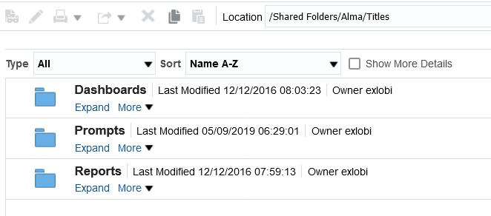
Accessing the default overlap reports and dashboard
The default overlap reports and dashboard use the “titles” subject area.
They are located under Shared > Alma > Titles

Slide 13
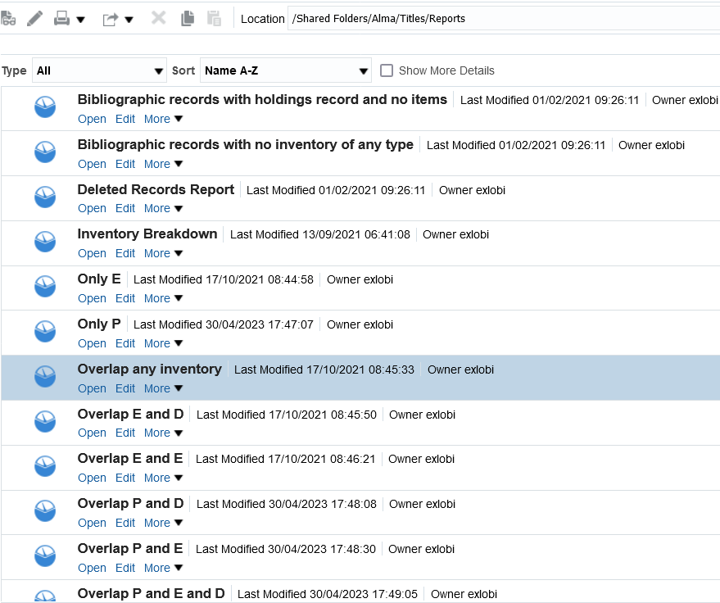
Accessing the default overlap reports and dashboard
These are the reports, described on the next slide
They are located under Shared > Alma > Titles > Reports
These reports are designed to be run as part of the dashboard and use the dashboard prompts. If copied locally they should be modified.

Slide 14
Accessing the default overlap reports and dashboard
Overlap E and D = Titles with inventory in both electronic and digital format
Overlap P and D = Titles with inventory in both physical and digital format
Overlap P and E = Titles with inventory in both physical and electronic format
Overlap P and E and D = Titles with inventory in both physical and electronic and digital format
Overlap P and P = Titles with two different bibliographic records for the same title and both bibliographic records have inventory in physical format
Overlap any inventory = This is an overlap analysis report which retrieves a list of titles for which there are at least two titles with any inventory.

Slide 15
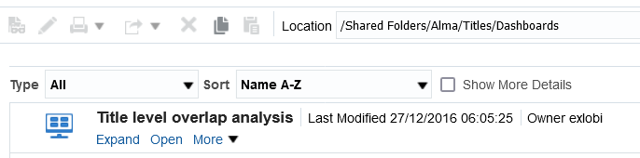
Accessing the default overlap reports and dashboard
The default dashboard is located under Shared > Alma > Titles > Dashboards
It is called “Title level overlap analysis”
The dashboard can be run from here by clicking “Open”

Slide 16
Determining the overlap analysis method

Slide 17
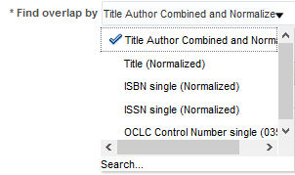
Determining the overlap analysis method
When the reports are run there are several prompts.
One of prompts is called “Find overlap by” and the user can choose the key which will be used to find the overlap. The options are (explained in next slide):

Slide 18
Determining the overlap analysis method
When the reports are run there are several prompts.
One of prompts is called “Find overlap by” and the user can choose the key which will be used to find the overlap. The options are:
  Normalized title
  A combination of the normalized title plus the first four characters of the author. This is the default. It is called “Title Author Combined and Normalized”
  ISBN
  ISSN
  OCLC control number from 035 subfield a

Slide 19
Determining the overlap analysis method
Several studies on a wide variety of data samples have shown that the combination of the normalized title plus the first four characters of the author is the most accurate key for finding overlap. It is not 100%, but it is very close to 100% and has the highest percent of all indexes.
For example, the physical and electronic titles of the same work will often have different ISBNs, or different ISSNs, or different control numbers, etc. But … they will at a very high percent level have the same normalized title and the same first four characters of the normalized author.

Slide 20
Determining the overlap analysis method
For example, we will now look at a typical case.
Title “Citizenship: feminist perspectives” by Ruth Lister.
It is the same title (work, manifestation).

Slide 21
Determining the overlap analysis method
The next slide shows a classic overlap of Electronic and Physical for the same title (work, manifestation). But … there is no 020 or 035 field in common.
The electronic version has these fields:
  020 __ |a 9780230802537 (electronic bk.)
  020 __ |a 0230802532 (electronic bk.)
  035 __ |a (OCoLC)ocn156874124
  035 __ |a (OCoLC)156874124 |z NetLibrary
The physical version has these fields:
  020 __ |a 0814751954 (cloth)
  020 __ |a 0814751962 (pbk)
  035 __ |a (DLC) 2003272252

Slide 22
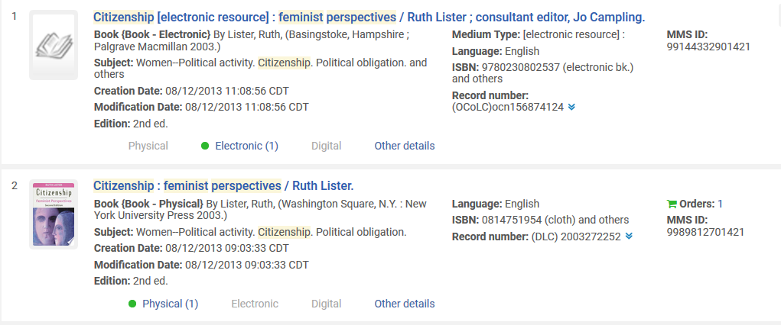
Determining the overlap analysis method
Same title (work, manifestation) but no common 020 or 035.

Slide 23
Determining the overlap analysis method
The match was found via the matching key of normalized title plus first four characters of the author.
Both records have this key of normalized title plus first four characters of the author
The catalogued titles do not match due to a colon in the first one, but the normalized titles match
Same author

Slide 24
Running the default overlap reports and dashboard

Slide 25
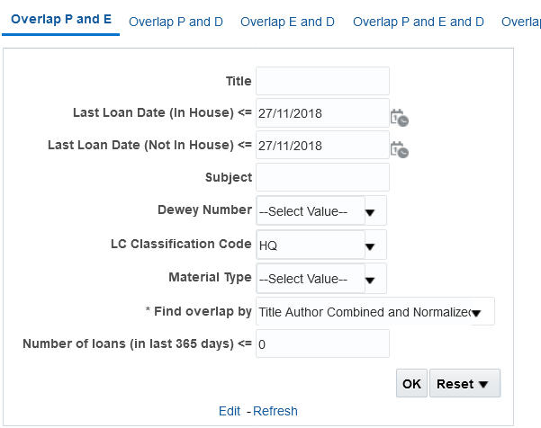
Running the default overlap reports and dashboard
Here is the overlap P and E tab of the Title Overlap Analysis dashboard. Let’s run it.
The physical item has not been loaned in at least 5 years
The bibliographic records have an LC classification code of HQ
The match is being done by field “Title Author Combined and Normalized”

Slide 26
Running the default overlap reports and dashboard
We will now look at the results.
These are the titles for which
  The LC Classification code is HQ
  There is both physical and electronic inventory
  The physical item has not been loaned for at least five years.
These are surely candidates for weeding.

Slide 27
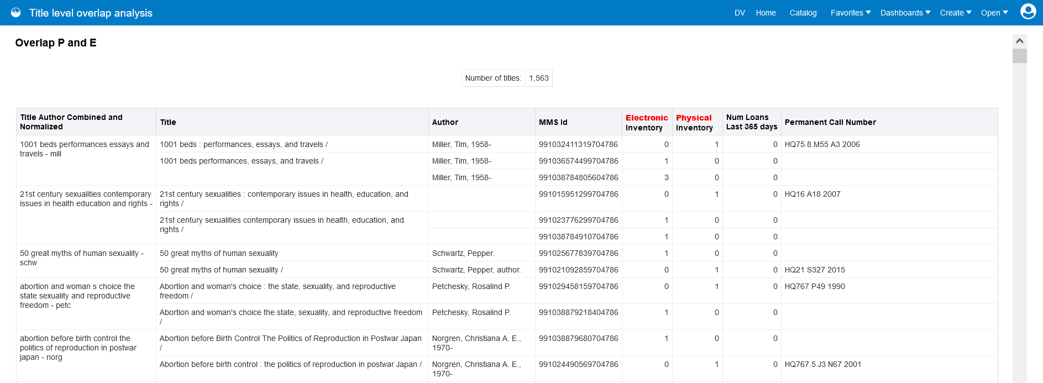
Running the default overlap reports and dashboard
Here are the first five results
We will now look at the first example

Slide 28
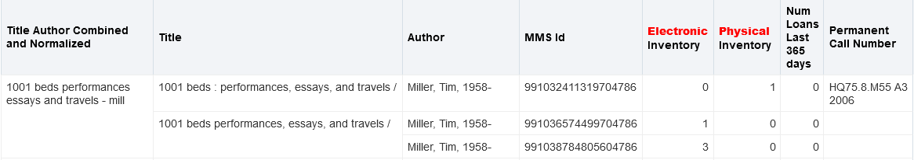
Running the default overlap reports and dashboard
There are three bibliographic records (three MMS IDs).
  The first one has one physical inventory.
  The second one has one electronic inventory
  The third one has three electronic inventory.

Slide 29
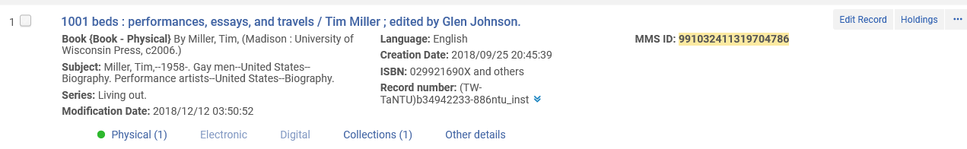
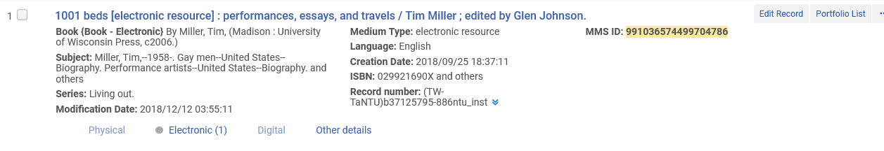
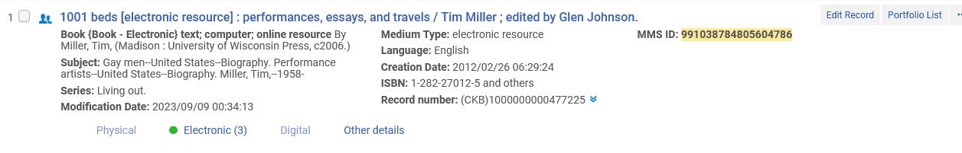
Running the default overlap reports and dashboard

Slide 30
Running the default overlap reports and dashboard
Open question: Does the library need to keep these items on the shelves?
These items have not been loaned for at least five years and there is an electronic version.
It is an “open question” and does not assume that these items must be weeded, as there are many other considerations as well.
But …. The report created from Alma Analytics overlap analysis is surely a good starting point in the evaluation.

Slide 31
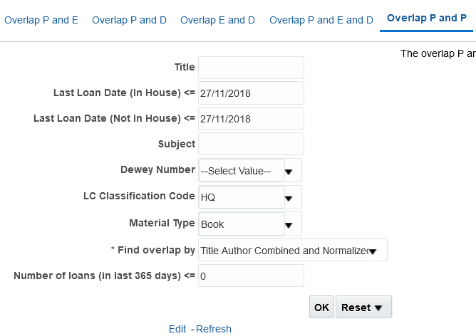
Running the default overlap reports and dashboard
Here is the overlap P and P tab of the Title Overlap Analysis dashboard. Let’s run it.
The physical item has not been loaned in at least 5 years
The bibliographic records have an LC classification code of HQ and item has material type “Book”
The match is being done by field “Title Author Combined and Normalized”

Slide 32
Running the default overlap reports and dashboard
We will now look at the results.
These are the titles for which
  The LC Classification code is HQ
  There are multiple bibliographic records and items for the same title
  The physical item has not been loaned for at least five years.
These are surely candidates for weeding.

Slide 33
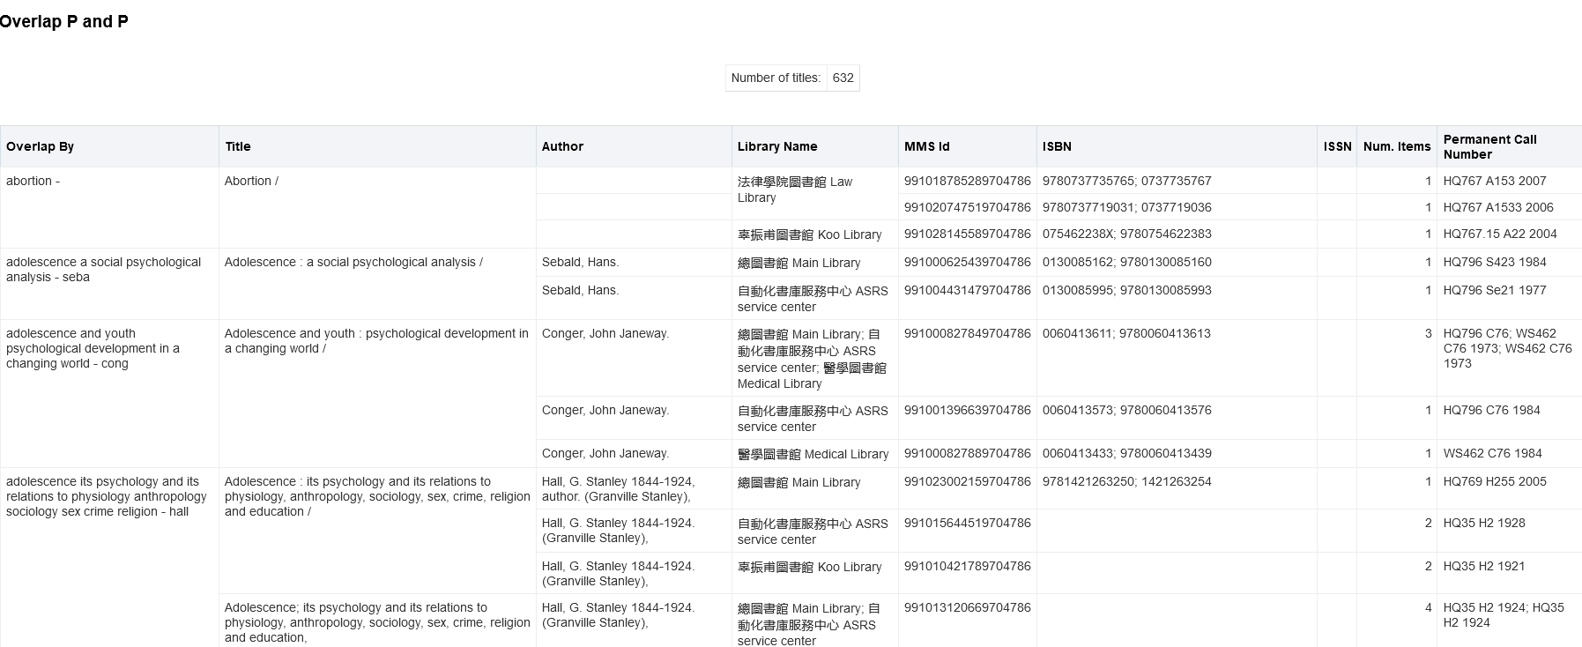
Running the default overlap reports and dashboard
Here are the first four results

Slide 34
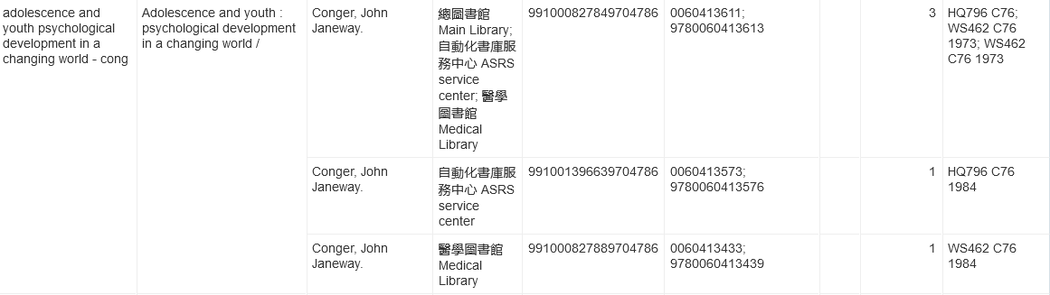
Running the default overlap reports and dashboard
Here is the third result. Three bibliographic records in three different libraries.
First one has three items, second and third have one item each.

Slide 35
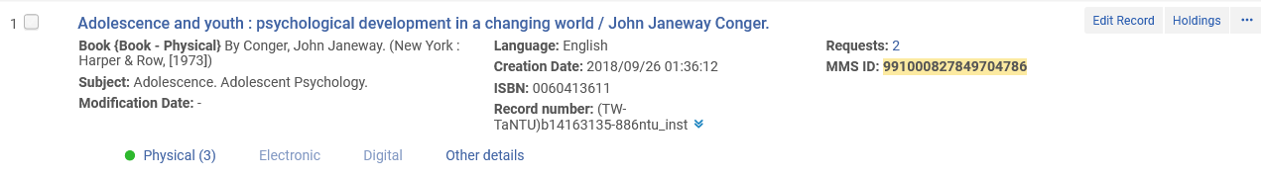
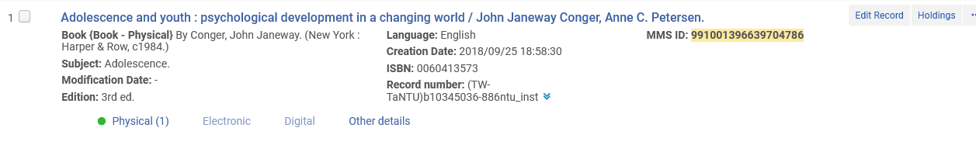
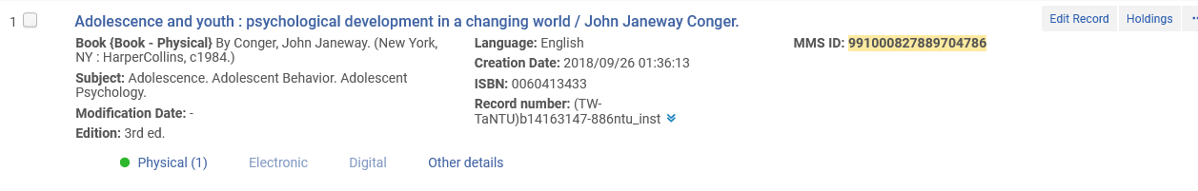
Running the default overlap reports and dashboard

Slide 36
Running the default overlap reports and dashboard
Open question: Does the library need to keep these duplicate items on the shelves?
It is an “open question” and does not assume that these items must be weeded, as there are many other considerations as well.
But …. The report created from Alma Analytics overlap analysis is surely a good starting point in the evaluation.

Slide 37
Running the default physical item usage for weeding report

Slide 38
Running the default physical item usage for weeding report
The tab “Physical Item Usage for Weeding” in the “Physical Items” dashboard is used to retrieved items older than a certain date (by item creation date) and not loaned since a certain date (along with additional optional criteria).
In this way it is possible to quickly and easily identify materials which have not been used or have only rarely been used in the last X years.

Slide 39
Running the default physical item usage for weeding report
The “Physical Item Usage for Weeding” retrieves physical items according to several criteria, among them are:
  Item Creation Date
  Last Loan Date
  Library Name
  Location Name
  Material Type
  Title
  Subject
  LC Classification Code
  Dewey Number

Slide 40
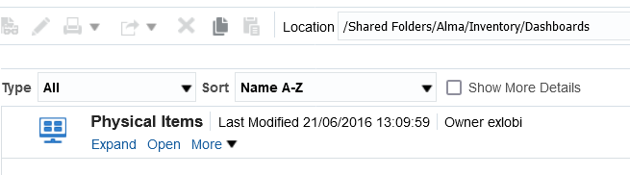
Running the default physical item usage for weeding report
The “Physical Items” dashboard is located under “Shared > Alma > Inventory > Dashboards” and contains a tab “Physical Item Usage for Weeding”

Slide 41
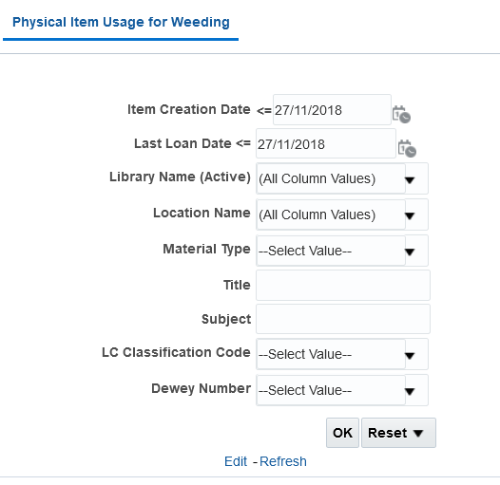
Running the default physical item usage for weeding report
The tab “Physical Item Usage for Weeding”

Slide 42
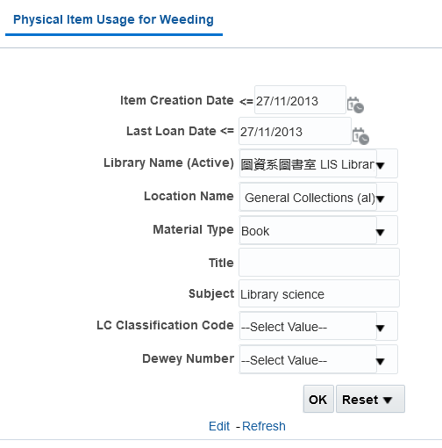
Running the default physical item usage for weeding report
The physical item was created at least ten years ago and has not been loaned in the last ten years
Items limited by
Library “LIS Library”
Location “Lib and Info Sci Dept Lib General Collections (al)”
Material type “Book”
The bibliographic records have Subject “Library science”

Slide 43
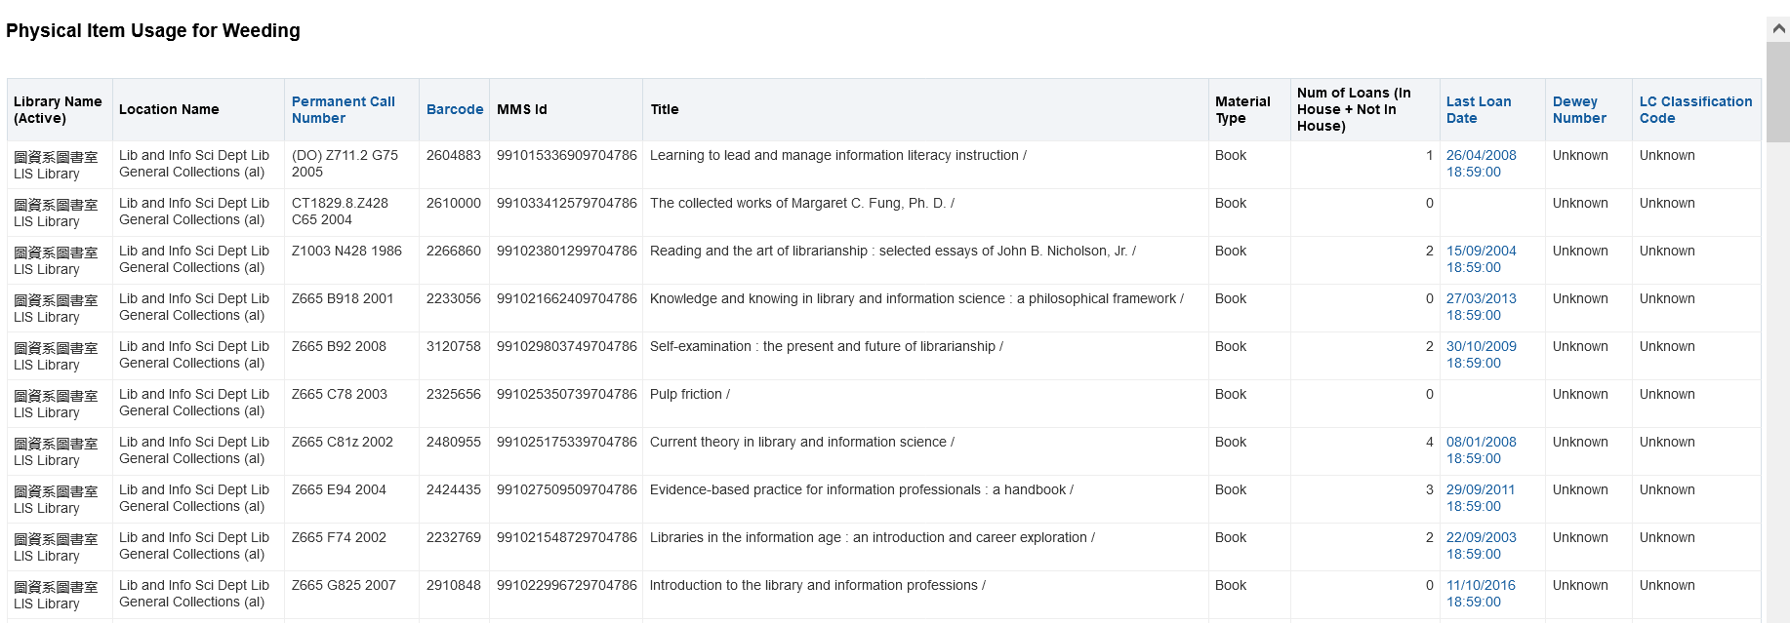
Running the default overlap reports and dashboard
Here are the first ten results

Slide 44
Running the default overlap reports and dashboard
Open question: Does the library need to keep these items on the shelves?
These items have been in the library for at least ten years and in those ten years they have not been loaned even once.
It is an “open question” and does not assume that these items must be weeded, as there are many other considerations as well.
But …. The report created from Alma Analytics overlap analysis is surely a good starting point in the evaluation.

